Slide 1
D a t a S c i e n c e
By – (Suruchi Pandey)

Slide 2
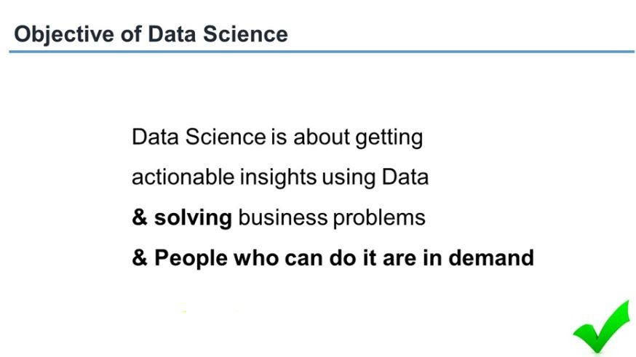

Slide 3
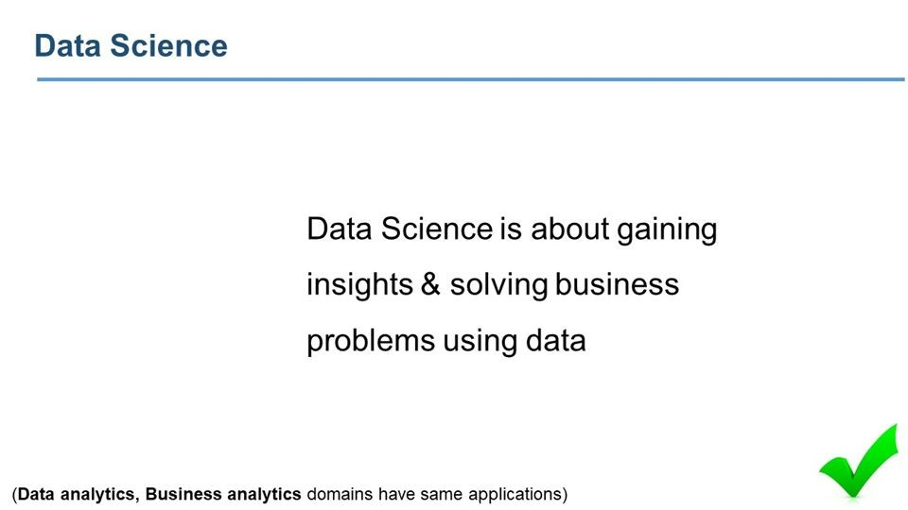

Slide 4
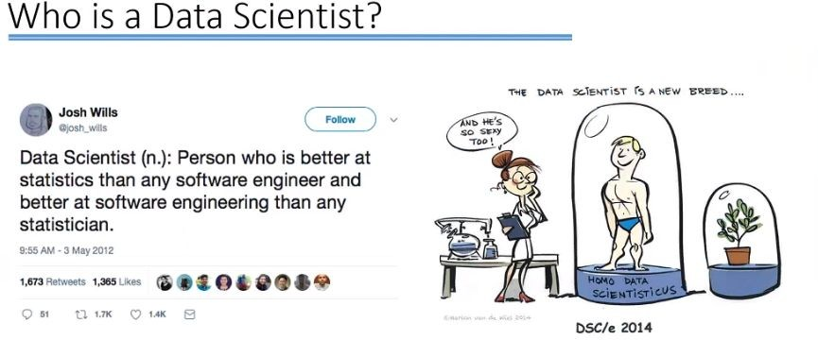

Slide 5
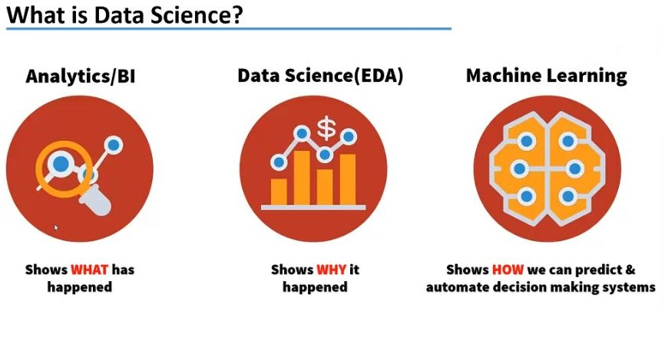

Slide 6
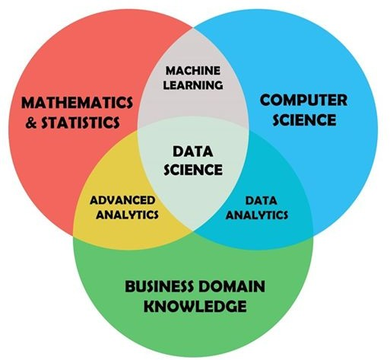

Slide 7
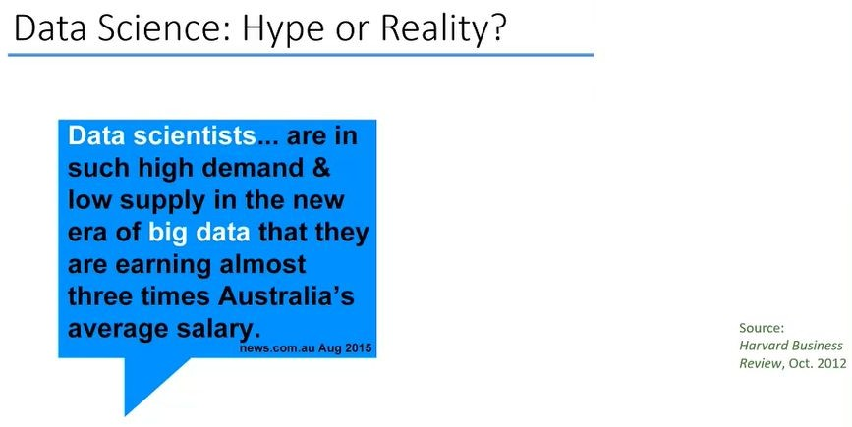

Slide 8
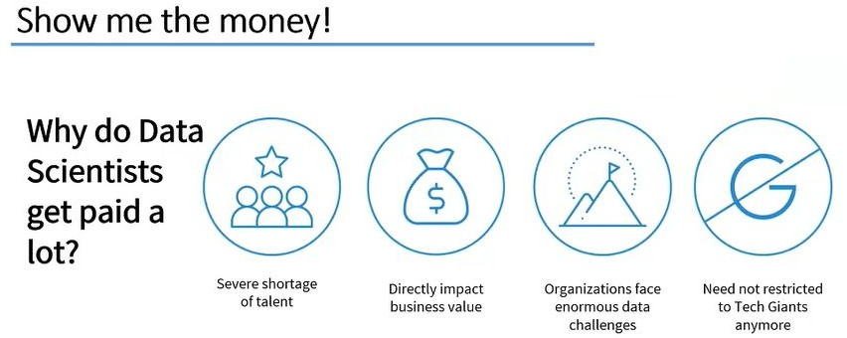

Slide 9
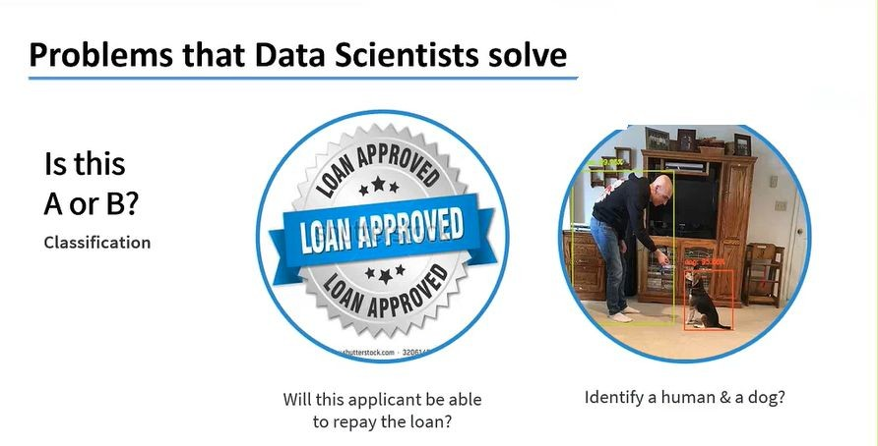

Slide 10
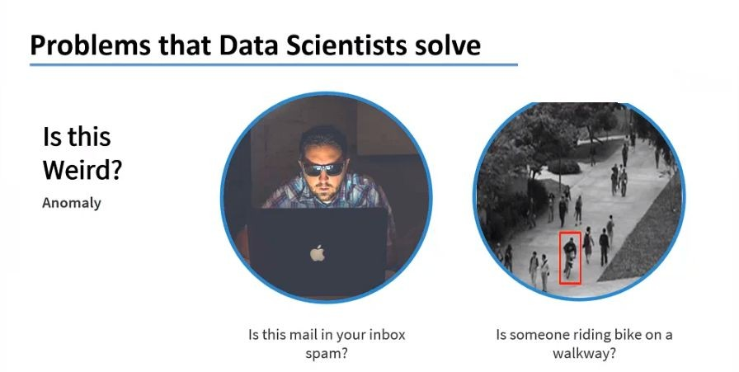

Slide 11
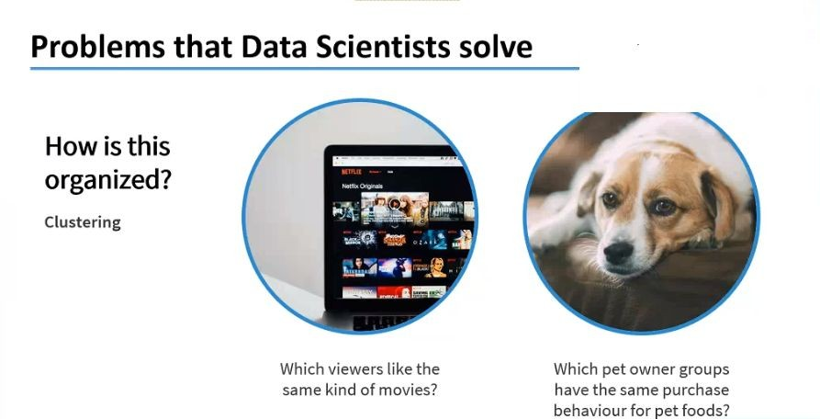

Slide 12


Slide 13
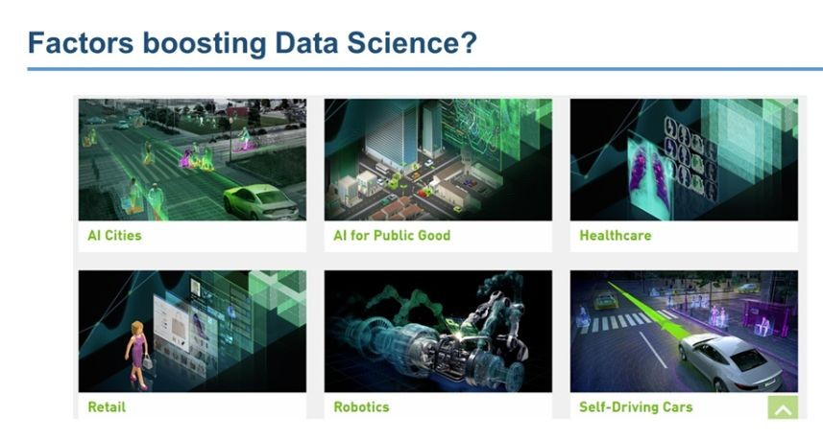

Slide 14
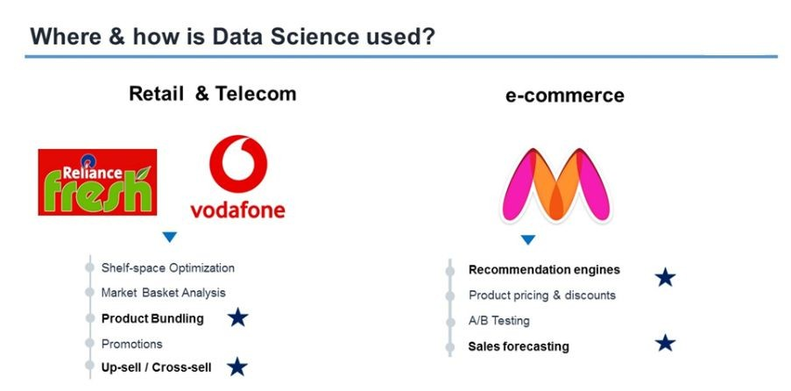
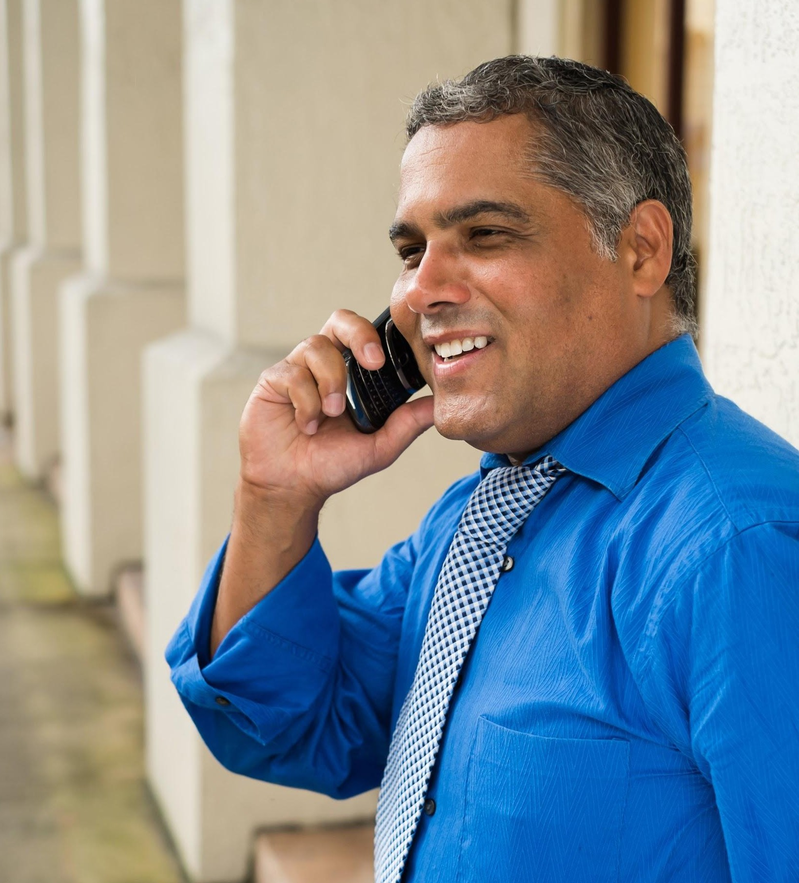


Meet Marcos.
He recently opened a camera shop near the Louvre in Paris.
Visitors to his store, mostly tourists, speak many different languages making anything beyond a simple transaction a challenge.
Tip
If one example isn’t suﬃcient to help people understand the breadth of your idea, pick a couple of examples.
Story for illustration purposes only

Slide 15
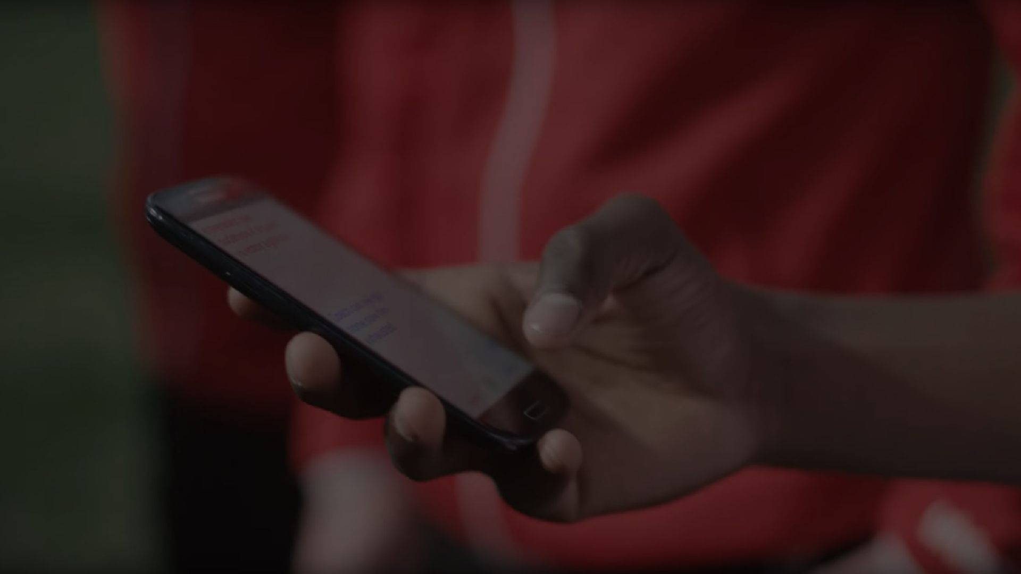
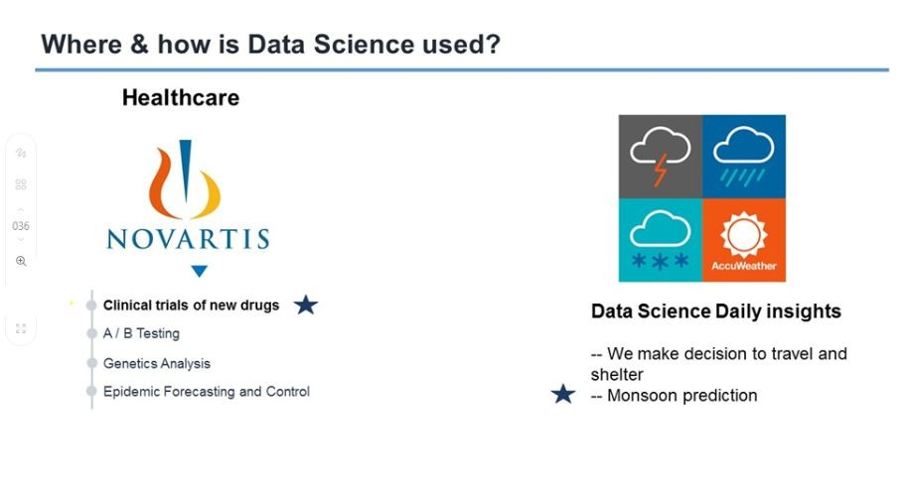
A translation barrier left Alberto feeling lonely and hurt Marco’s business.
Tip
Ideally, speak of people in very diﬀerent situations, but where each could beneﬁt from your solution.

Slide 16
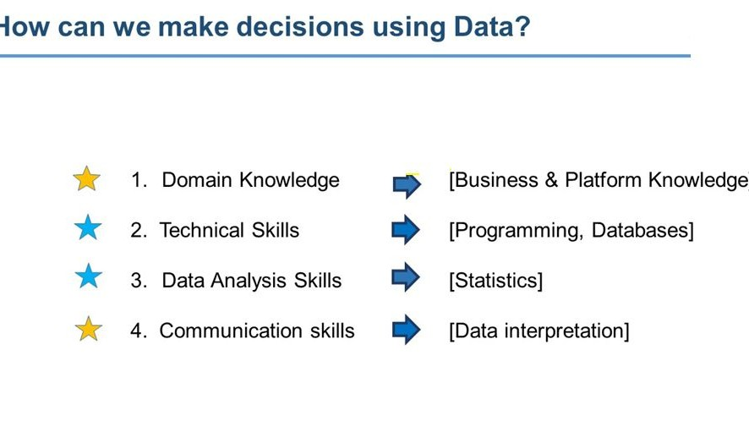
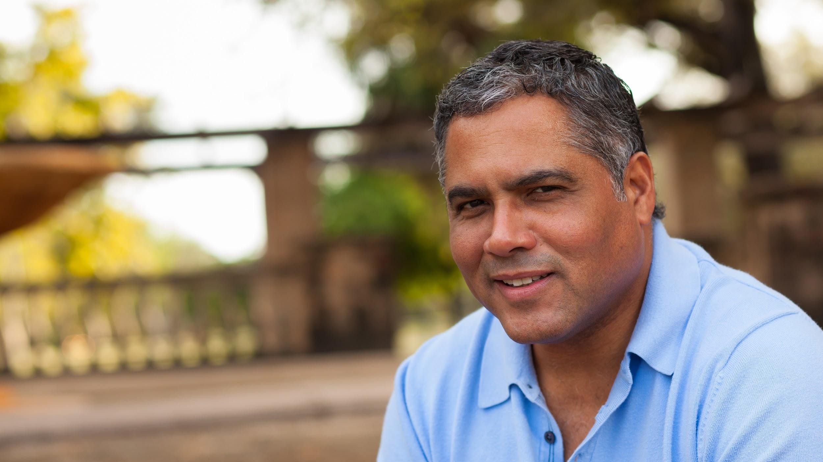
Then, Marcos discovered Google Translate
He has his visiting customers speak their camera issues into the app.
He’s able to give them a friendly, personalized experience by understanding exactly what they need.

Slide 17
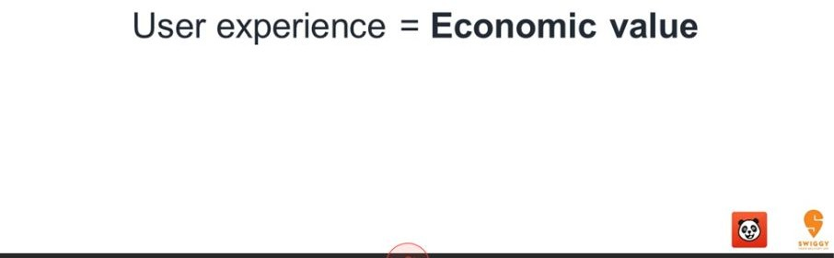

Slide 18
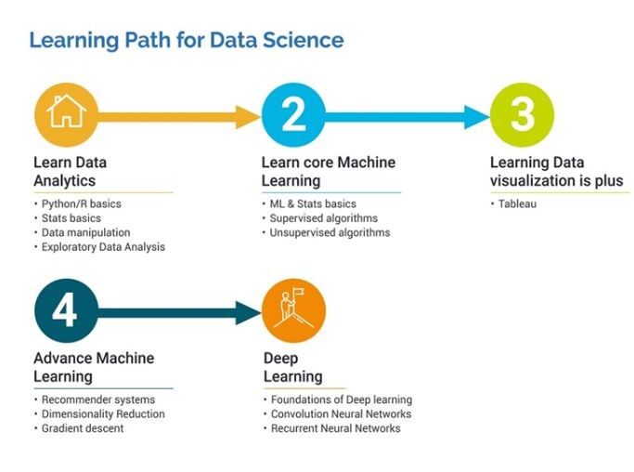
How many languages do
you need to know to communicate
with
the rest of the world?
Tip
In this example, we’re leading oﬀ with something unexpected.
While the audience is trying to come up with a number, we’ll surprise them with the next slide.

Slide 19
Thank You

